Slide 1

DriverPass System Analysis
Dylan Drake

Slide 2

System Requirements
Functional:
Allow students to schedule driving lessons online
Provide practice tests with instant feedback
Nonfunctional:
Mobile-friendly interface
Secure login and data protection
Notes:
The system will let students book lessons, take practice tests, and get immediate results. It will also work on all devices and keep all information secure.

Slide 3
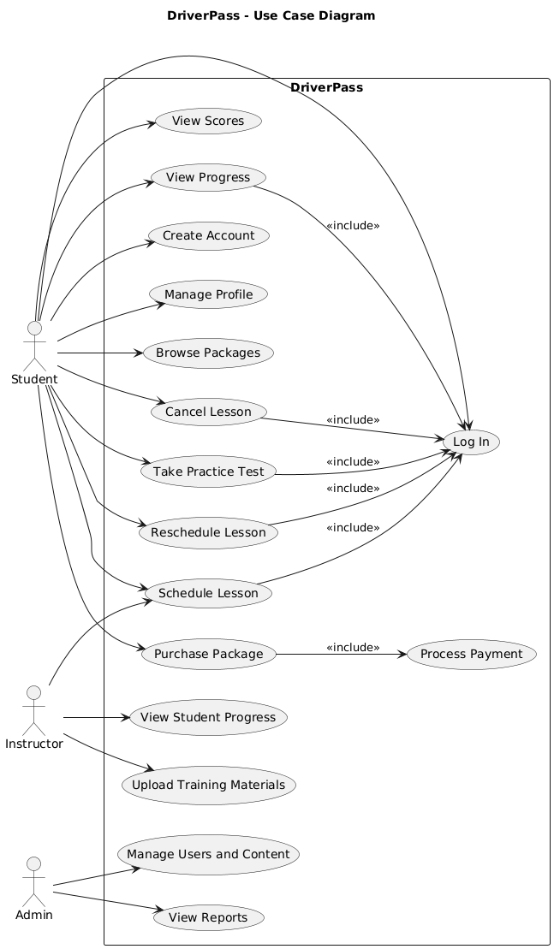
Use Case Diagram
Notes:
This diagram shows the main people who will use the system — students, instructors, and admins — and the actions they can take.

Slide 4
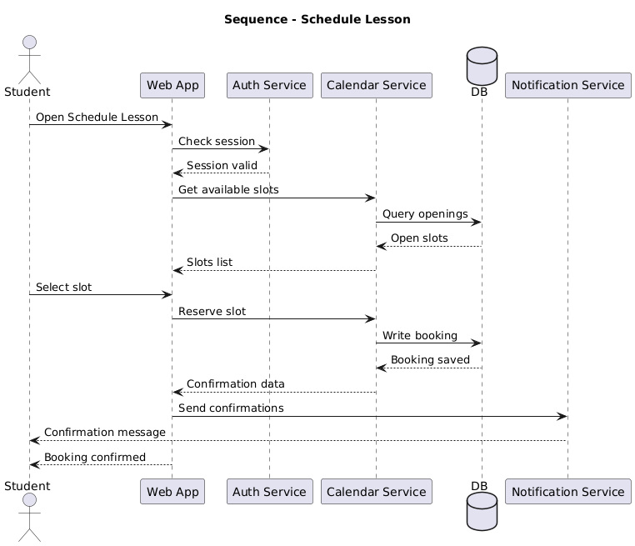
Activity Diagram
Notes:
This diagram walks through how a student books a lesson — from logging in to confirming their booking.

Slide 5
Security
Encrypted data storage
Secure HTTPS connections
User authentication with passwords and role-based access
Notes:
We’ve built in security features to protect sensitive information and ensure that only authorized users can access the system.

Slide 6
System Limitations
Internet connection required
Dependent on instructor availability
Practice tests limited to available question database
Notes:
These are the known limitations — all users will need internet access, scheduling depends on instructors, and the test questions are based on what’s currently in the database.

